Slide 1
Options Pattern in .NET

Slide 2
Introduction
What is the Options Pattern?
The Options Pattern is a way to manage configuration settings in .NET applications in a strongly-typed manner.
It simplifies working with settings and makes them easier to test, maintain, and manage in large applications.

Slide 3
Why Use the Options Pattern?
Benefits of Using the Options Pattern
Strongly-typed configurations instead of magic strings.
Centralized management of configuration settings.
Improved testability.
Easy to bind configuration values from `appsettings.json` or other sources.

Slide 4
How Does It Work?
Key Components of the Options Pattern
IOptions<T> Interface: Provides access to configuration values.Is registered as a Singleton and can be injected into any service lifetime.
IOptionsSnapshot<T>: Provides access to options that can be reloaded during runtime.Is registered as Scoped and therefore cannot be injected into a Singleton service.
IOptionsMonitor<T>: Similar to `IOptionsSnapshot<T>`, but can notify the app of changes to configuration.

Slide 5
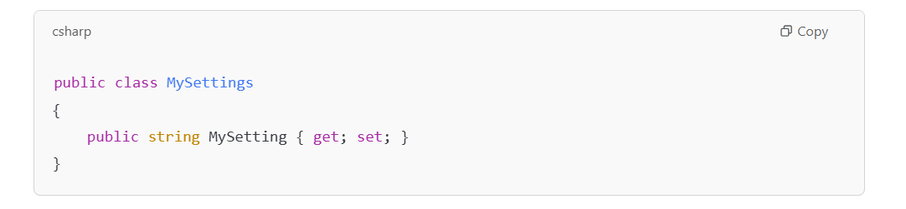
Basic Setup
Step 1: Install required NuGet Packages
`Microsoft.Extensions.Options`
Step 2: Define a configuration class (options class).
Step 3: Bind configuration to the options class in `Startup.cs` or `Program.cs`.
Example Code:

Slide 6
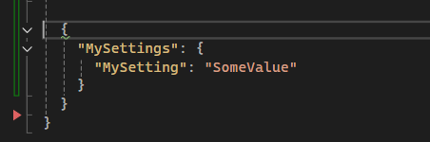
Binding Configuration
Binding appsettings.json to Strongly Typed Configuration
Example appsettings.json:

Slide 7
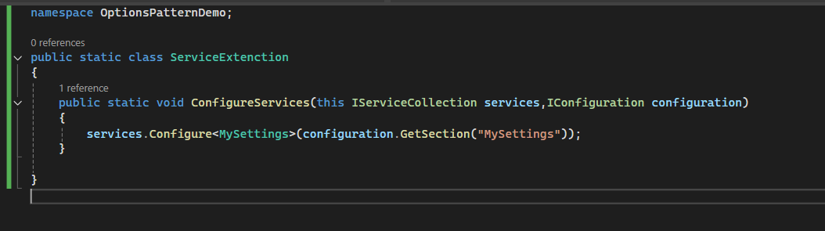
Code to Bind:

Slide 8
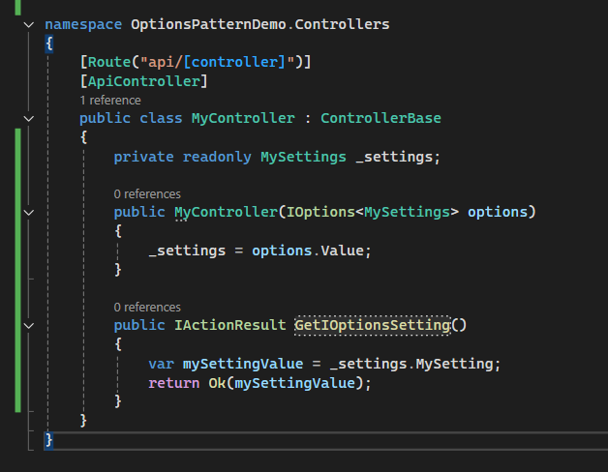
Accessing Configuration in Code
Using `IOptions<T>` to Access Configuration
Example:

Slide 9
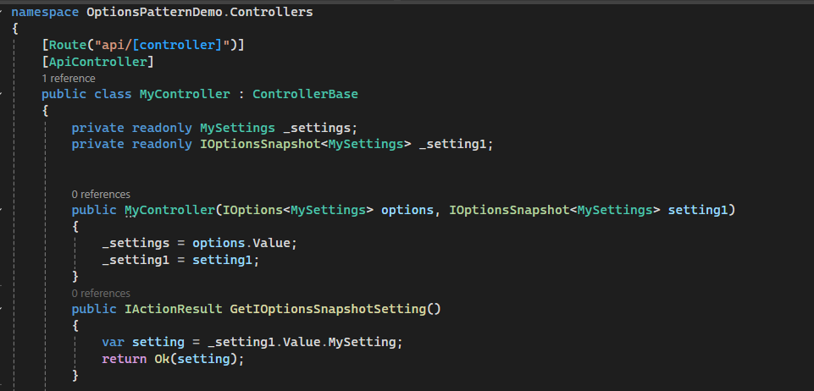
IOptionsSnapshot and IOptionsMonitor
IOptionsSnapshot
Used for accessing options with a lifetime tied to a request (useful in scoped services).
Can access updated values if configuration changes during runtime.
Example:

Slide 10
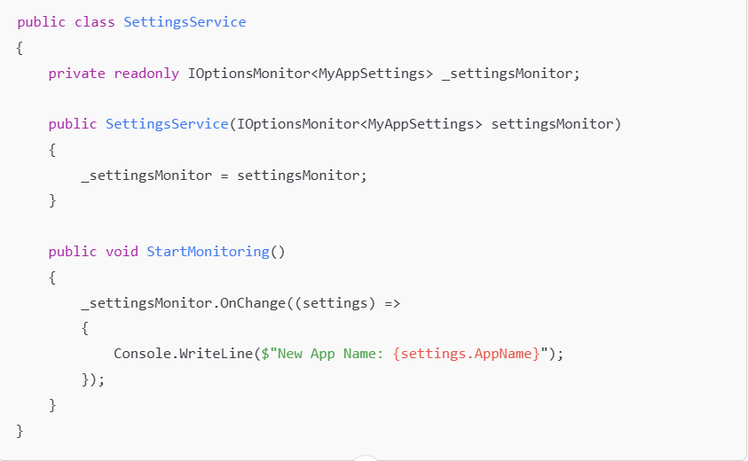
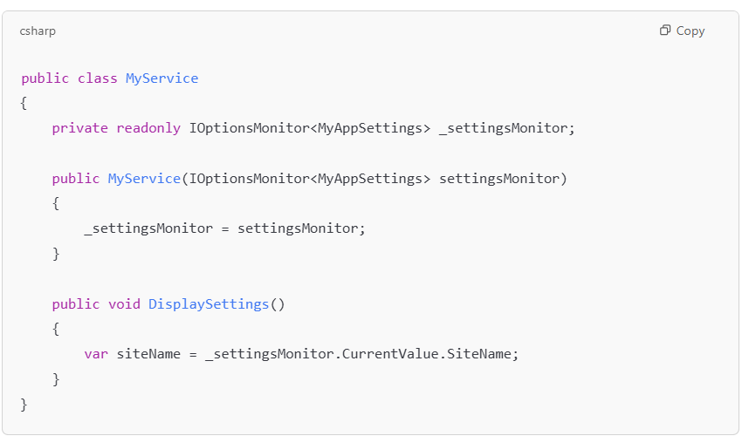
IOptionsMonitor
Provides the ability to subscribe to changes in options during runtime.
When to Use: Ideal for apps that need to react to configuration changes at runtime.
Dynamically Handling Changes

Slide 11
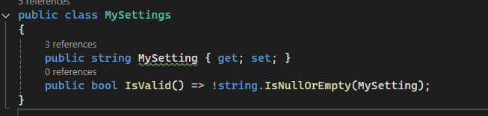
Options Validation
Ensuring Valid Options Data
Add validation to ensure options meet certain conditions.
Example:

Slide 12
Scenarios and Use Cases
When to Use Options Pattern
Multi-environment configuration handling.
Handling complex settings that need validation.
Large applications with many settings that need organization.

Slide 13
Common Mistakes to Avoid
Common Pitfalls
Not validating options before using them.
Using IOptions<T> when IOptionsSnapshot<T> or IOptionsMonitor<T> would be a better choice.
Forgetting to register options in Startup.cs or Program.cs.
Treating options as a singleton when they are request-scoped.

Slide 14
Best Practices
Best Practices
Use separate configuration sections for different parts of the app.
Leverage validation to catch errors early.
Always prefer strongly-typed settings over magic strings.
Use IOptionsSnapshot for scoped services.

Slide 15
Example Real-World Application
Demonstration of Options Pattern in a Web API or MVC Application
Example of an application that uses options to configure database connection strings, API keys, and external service configurations.

Slide 16
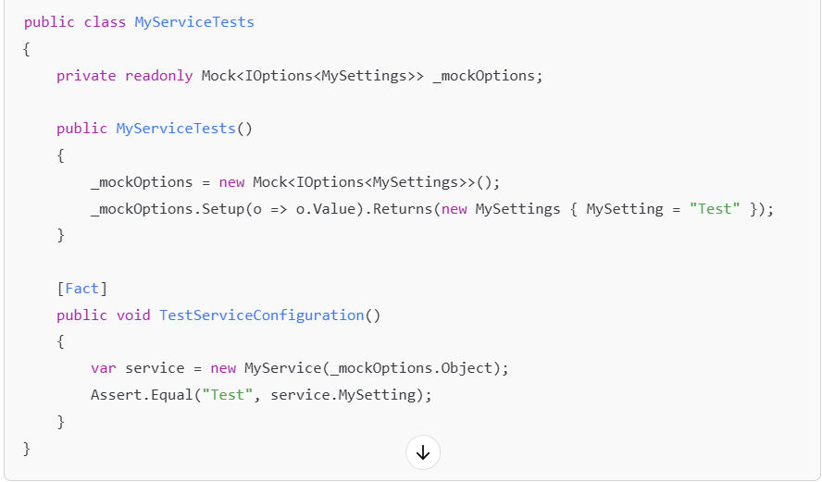
Testing with Options
Unit Testing with IOptions
Mocking IOptions<T> in unit tests.
Example test case using MSTest or xUnit.
Emaple:

Slide 17
Recap and Q&A
Key Takeaways
The Options Pattern helps organize and manage configurations effectively in .NET.
It supports dependency injection, validation, and testability.
Use IOptions, IOptionsSnapshot, and IOptionsMonitor based on your app's needs.
Q&A Time: Open the floor to questions.

